Slide 1


Cross-platform mobile development with C#
Xamarin and MvvmCross

Slide 2
The future is mobile!
More current graphs?
IDC/Nielsen 2012

Slide 3
Agenda
Introduction 10’ olb
Initial position
Challenges in mobile development
Code-sharing using Xamarin and MvvmCross
Building the “Zühlke X-Platform Messenger” 40’ ssh/urb
Questions (concerning the app)
myBosch App: Experiences 5’ kwl
Zühlke as Xamarin’s Premium Consulting Partner 5’ kls
Discussion 20’
Wrap-up 5’ olb

Slide 4



Initial position
.NET development team (C#)
Customer database
Cloud service (Azure) providing a REST API
Business layer (.NET) for using services
Zühlke Messenger
Service (Azure)
?
PCL?
Business layer (.NET)
HTTP

Slide 5
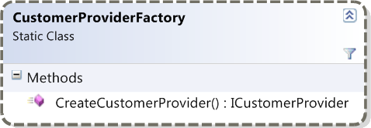
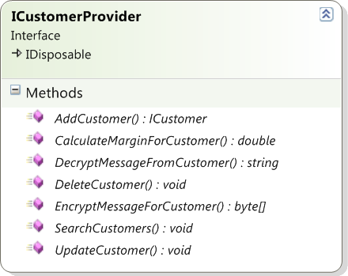
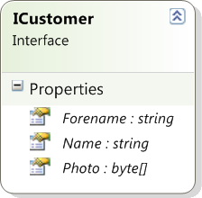
Business layer
Update!

Slide 6

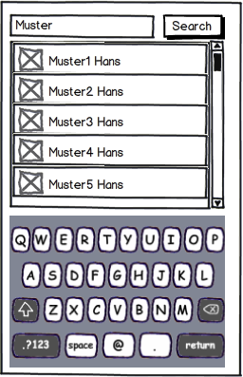
User Interface Mockup
Update!

Slide 7
Web, hybrid or native?
Criteria | Web | hybrid | native
User Experience |  |  | 
Performance |  |  | 
Offline capability |  |  | 
Hardware |  |  | 
Payment models |  |  | 
Multi-platform |  |  | 
Abstraction |  |  | 
Deployment |  |  | 

Slide 8
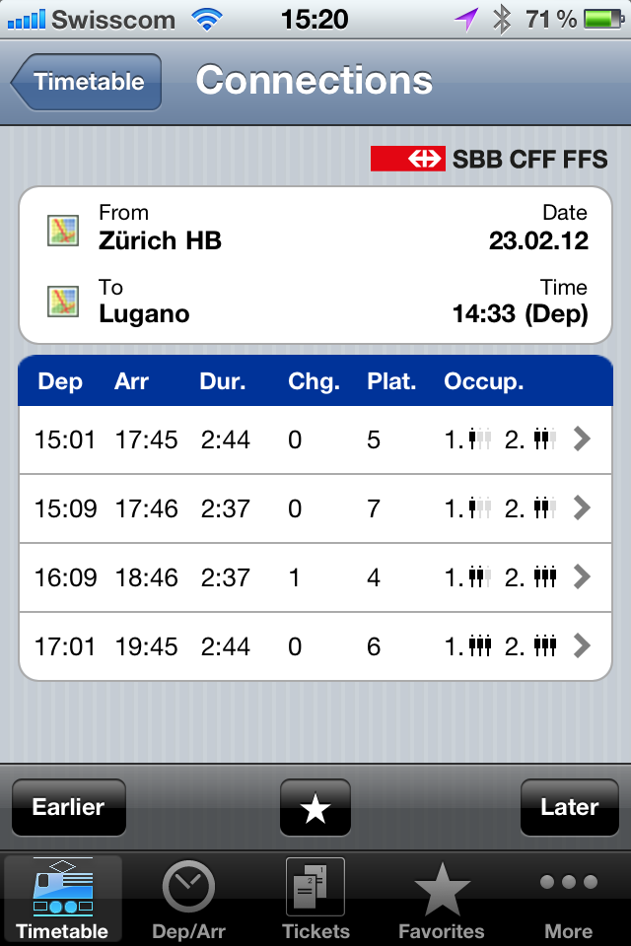
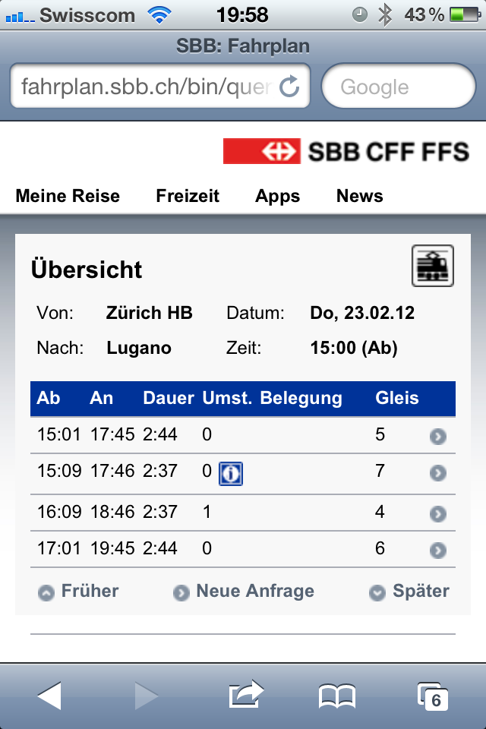
Example: Native vs. Web
Native
Web
Interaction elements
Deployment, updates
Offline capability (Buy ticket)
Hardware (Shake for most current ticket)
80 %
20 %
Online time (mobile devices)
Stefano Malle (Microsoft), 2012

Slide 9


Code sharing using Xamarin and MvvmCross
Xamarin
MvvmCross
User interface
User interface
View
View
ViewModel
ViewModel
ViewModel
Model
Model
Model
Business layer
Business layer
Business layer
Service (Azure)
HTTP
HTTP

Slide 10
Tooling setup

Slide 11
MvvmCross setup with Nuget

Slide 12
MvvmCross as IoC container

Slide 13
Shared model/view model

Slide 14
MvvmCross data binding

Slide 15
SQLite with LINQ

Slide 16
Plug-in system

Slide 17
Including HTML5 content

Slide 18
REST with RestSharp/Json.NET

Slide 19
Client-side cryptography

Slide 20
Unit testing (crypto service)

Slide 21

Questions (concerning the App)

Slide 22
myBosch App: Experiences
Kerry Lothrop

Slide 23
Zühlke as Xamarin’s Premium Consulting Partner
Klaus Liebe

Slide 24

Discussion

Slide 25



About us
Ursin Brunner
Software Engineer
SWE-PRO/JAP
Stefan Schöb
Software Engineer
SWE-EPS/ESI
Klaus, Kerry, etc.?
Oliver Brack
Nearshoring Manager
Zühlke Serbia

